Slide 1
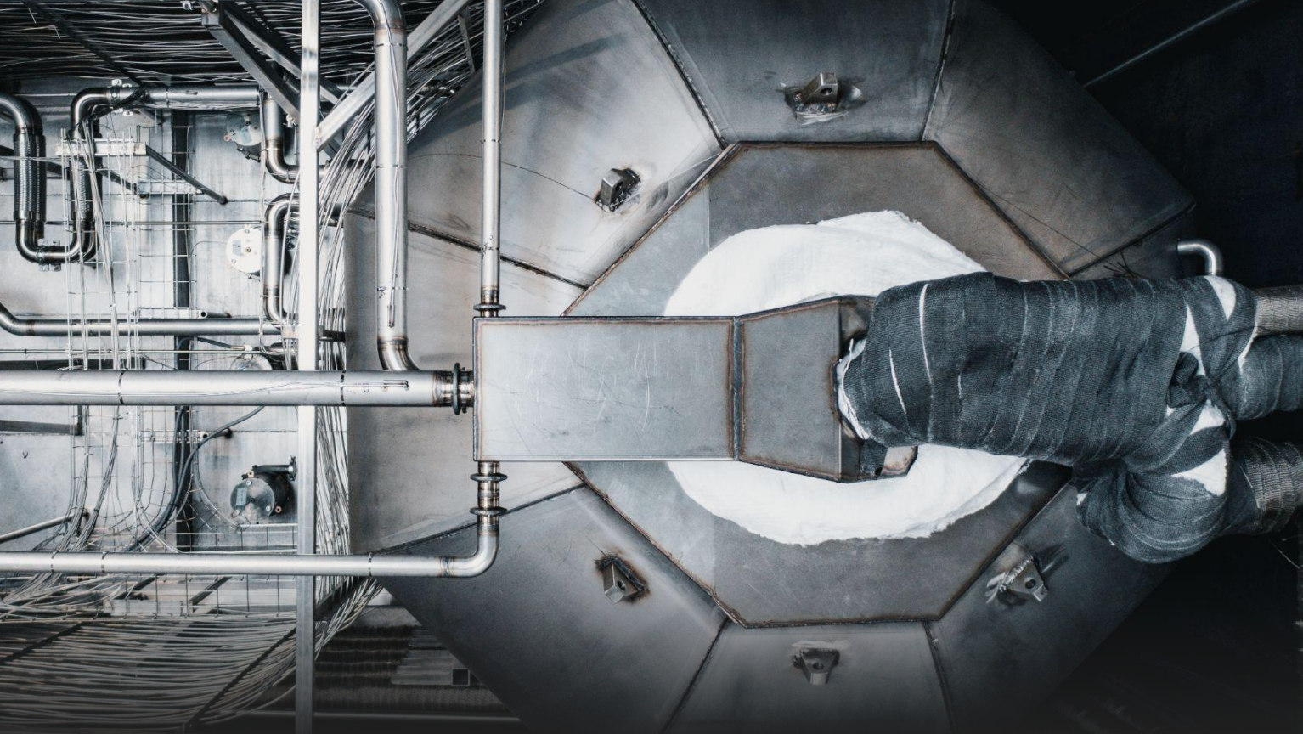



NE9 Coursework 1 copenhagen atomics
Andy Zhang, Lea Girard, Shaadia Cader, Yoni Fridman

Slide 2
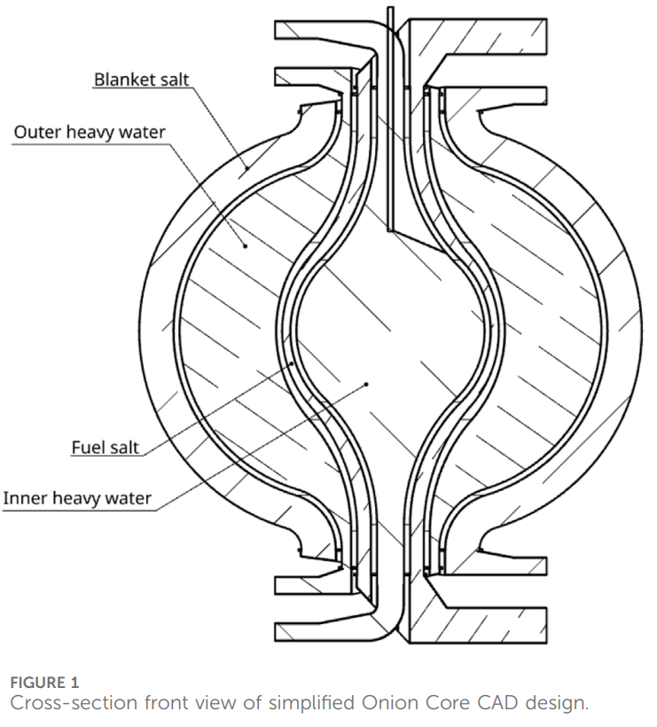
Chierici L and Rossi A (2025) Multi-step verification of the Copenhagen atomics molten salt experiment radioactive inventory at the Paul Scherrer Institute using OpenMC, Serpent, and EQL0D. Front. Nucl. Eng. 4:1677436. doi: 10.3389/fnuen.2025.1677436

Slide 3
Chierici L and Rossi A (2025) Multi-step verification of the Copenhagen atomics molten salt experiment radioactive inventory at the Paul Scherrer Institute using OpenMC, Serpent, and EQL0D. Front. Nucl. Eng. 4:1677436. doi: 10.3389/fnuen.2025.1677436

Slide 4
Chierici L and Rossi A (2025) Multi-step verification of the Copenhagen atomics molten salt experiment radioactive inventory at the Paul Scherrer Institute using OpenMC, Serpent, and EQL0D. Front. Nucl. Eng. 4:1677436. doi: 10.3389/fnuen.2025.1677436

Slide 5









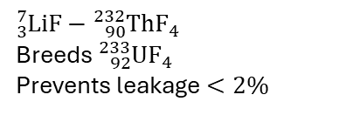


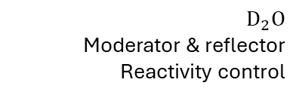
Inner heavy water
${80}^{−} °C$
Fuel salt
$700 °C$
Outer heavy water
${80}^{+} °C$
Blanket salt
$600 °C$
Outer heavy water
$$D_{2}O$$
Moderator & reflector
Fuel salt
$${}_{3}^{7}{\text{Li}}F−{}_{90}^{232}{Th}F_{4}−{}_{92}^{233}UF_{4}$$
$\text{Li}$ enriched to $99.99\% {}_{3}^{7}{\text{Li}}$
Insulation layer
$SiC/SiC$ ceramic + aerogel
Thermal & corrosion resistant
Blanket salt
$${}_{3}^{7}{\text{Li}}F−{}_{90}^{232}{Th}F_{4}$$
Breeds ${}_{92}^{233}UF_{4}$
Prevents leakage $<2\%$
Inner heavy water
$$D_{2}O$$
Moderator & reflector
Reactivity control
Blanket salt
$600 °C$
Outer heavy water
$${80}^{−} °C$$
Inner heavy water
$${80}^{+} °C$$
Fuel salt
$600 °C$

Slide 7
30 mbar

Slide 8

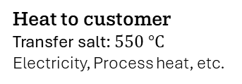


Shipping container
Insulated section
Easy to transport
Mass production: 1/day
Contains high temperatures
30 mbar
Coolant water out
$H_{2}O$: $25 °C$
Heat to customer
Transfer salt: $550 °C$
Electricity, Process heat, etc.
Transfer salt return
Transfer salt: $450 °C$
Coolant water in
$H_{2}O:$ $5 °C$
Intermediate salt loop
Emergency drain tanks
At least 3 barriers of protection
Subcritical drain tanks for passive safety

Slide 9

30 mbar

Slide 10
30 mbar

Slide 11

2 bar
30 mbar
Fission Products

Slide 12
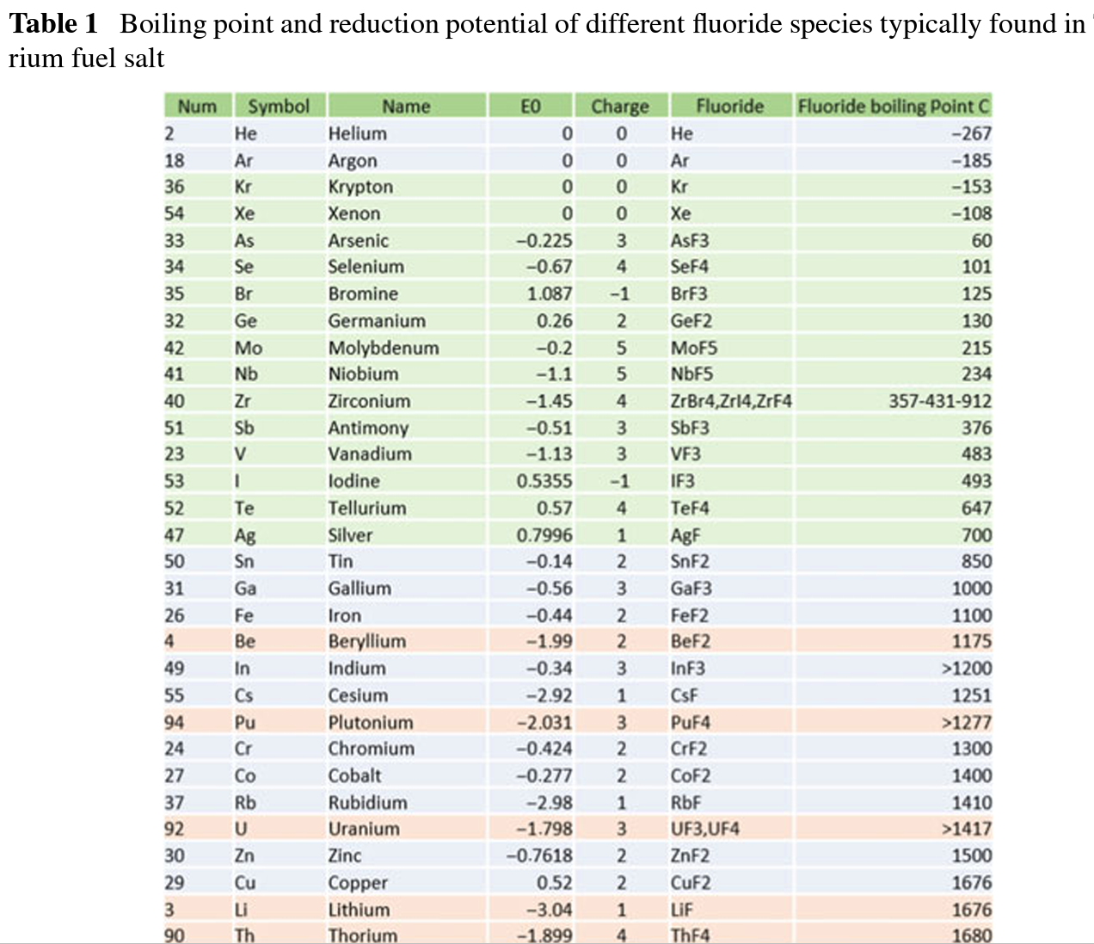
2 bar
30 mbar
Fission Products
Pedersen, T.J. (2019). Fission Product Removal by Vacuum Spraying in a Heavy Water Moderated Molten Salt Reactor. In: Nayak, A., Sehgal, B. (eds) Thorium—Energy for the Future. Springer, Singapore. https://doi.org/10.1007/978-981-13-2658-5_34
Cocoon
Containment building: Protects against plane crashes, seismic activity, etc.
Assembled on site

Slide 13
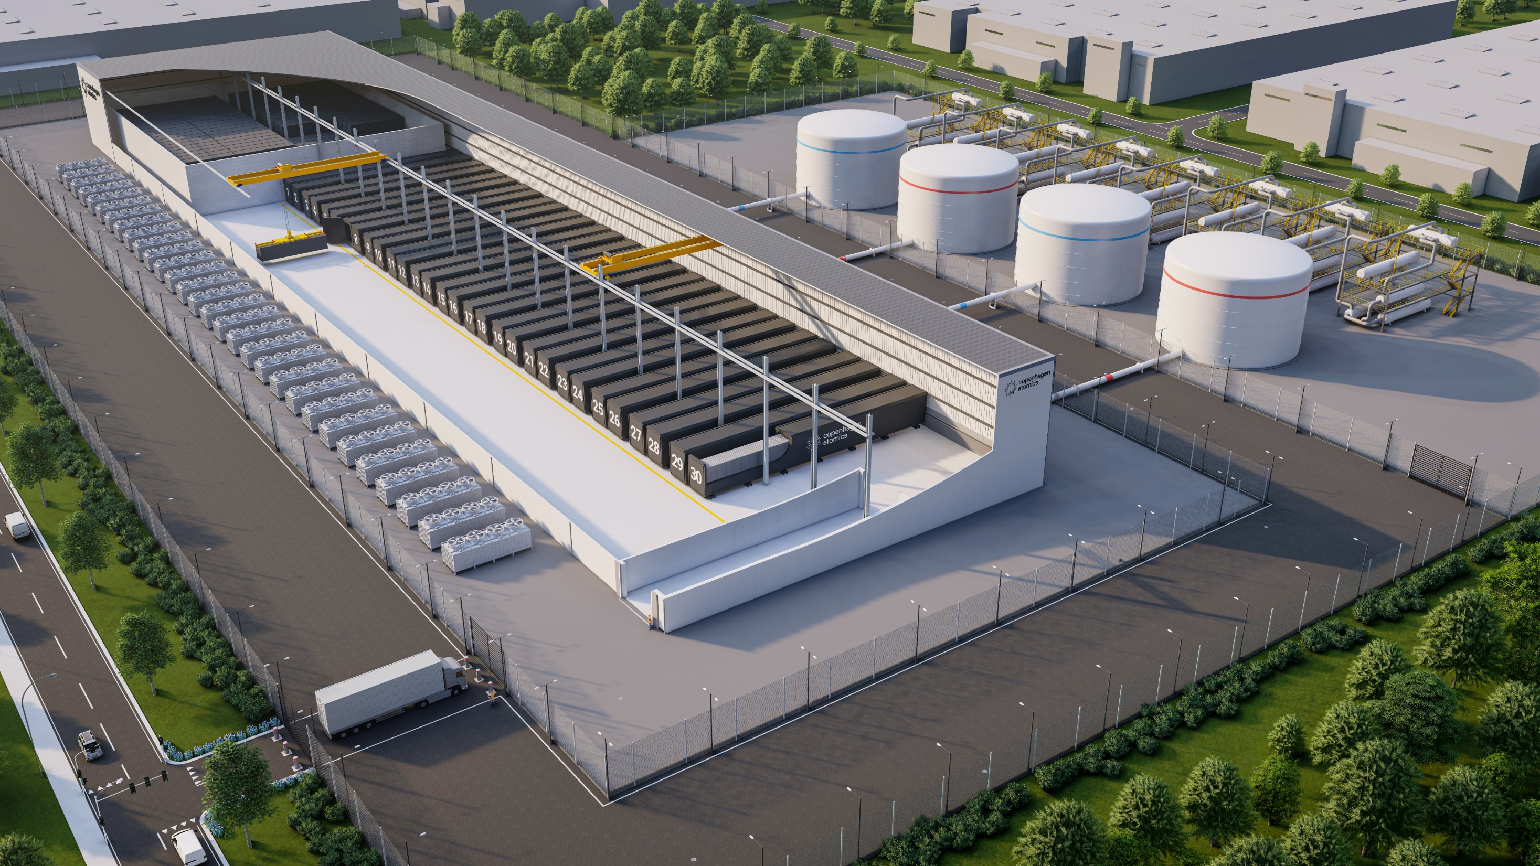

Slide 14
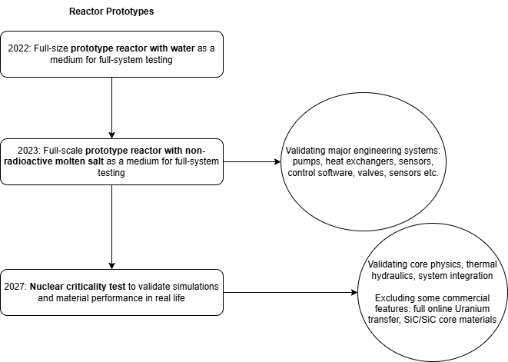
Status and Maturity of the Technology and Design

Slide 15
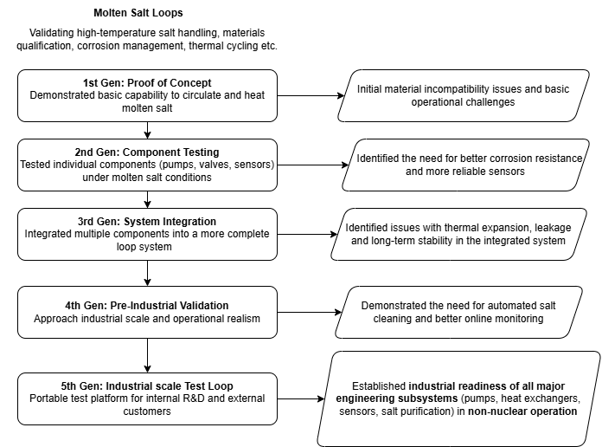
Notes:
Tests up to now with fluoride, chloride and nitrate salts (non-radioactive salts); next year they plan on testing with radioactive uranium and thorium salts

Slide 16
Unsolved Technical Challenges
Long-term performance of advanced core materials (e.g., SiC/SiC Composities)
Radiation damage and structural integrity
Aggressive corrosion under molten salt and temperature conditions
Thermal cycling and mechanical stress
Difficulties in production of large, defect-free SiC/SiC components
Regulatory qualification still far away for SiC/SiC composites
Industrial-scale Li-7 enrichment for optimal neutron economy
Extremely high purity enrichment of Li-7 is required (99.99% Li-7) due to high neutron absorption cross-section of Li-6
Even small traces of Li-6 can have a large negative impact on reactor performance, breeding ratio and operator safety (due to alpha particle and Tritium production)
Existing industrial processes for lithium isotope separation are limited in scale and efficiency
High-purity enrichment at commercial scale has not been demonstrated
High cost of enrichment
Fully automated online FP removal and Uranium transfer from blanket to fuel salt
Technically challenging, precise chemical separation processes are required for these operations
Corrosion and fouling of separation equipment
Automation risks for precise tasks and reliability of long-term, continuous monitoring must be secured
Proliferation risks with automated U-233 transfer must be addressed to the satisfaction of regulators
Notes:
Long-term performance of advanced core materials (e.g., SiC/SiC composites)
Industrial-scale lithium-7 enrichment for optimal neutron economy
Fully automated, online fission product removal and uranium transfer from blanket to fuel salt

Slide 17
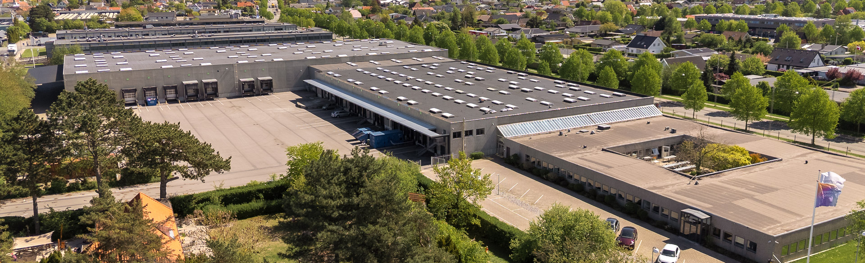
Next Stages
Nuclear Demonstration, Commercialisation and Regulatory Path
The first nuclear demonstration is planned at the Paul Scherrer Institute (PSI) in Switzerland, with criticality targeted for 2027.
Subsystems are already being mass-produced with the supply chain for key components established. The reactor core is expected to have a lifespan of 3-5 years in early deployments. Regulatory approval is being pursued, including in potential host countries.

Slide 18
Pump reliability
Keeping liquid fuel circulating reliably at temps above 600 for years.
Company has >2 years of operation of pumps - which is still well short of demonstrating it will work for decades
Canned pump with no dynamics seal (what theyre pumping is also radioactive!)
Corrosion
Fluoride salts at high T extremely corrosive (attack most metals, dissolve surface oxides )
In combination with high DPM from flux - can degrade materials at v high rates
Pumps, pipes, rpv must be able to withstand this
What materials and what cost can survive decades of chem + rad attack is big question
Neutrons validcation
Run extensive comp modelling of how reactor will behave, but needs to prove in tests
PSI switzerland will be doing testing so thats a big thing
Online fp removal
Unlike normal fuel rods where fps stay inside rods, fps are dissolved or suspended in fuel
Particularly gaseous fps like xenon can suppress fission - requires online FP extraction
They have built a physical salt loops that tests fp removal - non rad salt only
PSI tests will only remove some as its simpklfied experiment, nor is transfer of uranium from blanket to fuel
Noone has tested online fp removal
Hard to test as fps are hard to produce w out fission - importantly xenon 135 , cant really test whole system till its run under flux
Thorium breeding cycle
1st commercial reactros wont be full breeder (aiming for ratio approaching 1) so iso breeders - long temr commercial and energy security case rests on this tho
Regulatory Approval for a Liquid-Fuel Reactor
No reg framework in europe for liquid fuelled reactor
All existing reg based on trad lwrs
Manufacturing at scale
They have very ambitious goal of eventually making 1 reactor per day at low costs
Fundamentally different challenge to building a one off prototype
Unproven for any nuclear tech - let alone a novel reactor like this.

Slide 19
Should be cheap

Slide 20
For a nuclear country
Does not replace PWR but adds some benefits
High temperature heat
Main important aspect : providing heat at 550°C. The “state” of heat (salt medium) can make it easier to transport and / or store. Considered “medium” heat for industry applications. Cannot reach steel or cement but can do “basic” industrial processes like paper, oil refinery and plastics, food industry, textiles and quite importantly hydrogen production.
In nuclear countries with PWRs, population that accepts them and access to uranium + enrichment the CA reactor might not be very useful. Probably only decarbonized heat.
Collaborating with Topsoe, Alfa Laval, and Aalborg CSP on a proposed $4 billion, 1 GW green ammonia plant in Indonesia.
If some people freak out about waste again, could be good for burning actinide waste (good neutron economy).
They are actually proposing to buy waste, not sell the “transmutation capacity”.
Partnering with DeepGeo to develop backend solutions for spent fuel, aiming to convert it into a resource.
Would also be good for remote communities.
Little refuelling, thing is sealed and one package. Reactor can be transported, although you do need the heat transformer to be built locally, so no “nuclear barge” situation. Does not require fissile refuelling, only refuelled with Thorium (fertile) every 10 years (!!!).
Partnering with Ocean-Power AS to explore offshore thorium-based energy solutions.

Slide 21
For a non nuclear country
Political stuff.
Could work for a smaller non nuclear nation, or one that has been afraid of nuclear and wants something new and different. In which case would “replace PWR” (be able to go where PWR cannot).
Safety : no pressurization, no maintenance, cocoon is always sealed.
No long live waste produced. No spent fuel at all ! Only fission products. Could be useful for a country that does not already have long lived waste to avoid the issue of geological storage entirely.
Based on Thorium : could be good for a situation without access to uranium and/or enrichment capabilities (even though with new systems getting uranium out of ocean water we see less need for uranium sustainability)
No need for heavy governmental infrastructure like fuel retreatment.

